Slide 1
VOCAB REVIEW
1. Cut your words apart.
2. Not Honors? You can throw out the Honors words if you want.
3. Arrange your words into piles based on meaning. You will have to explain your piles.

Slide 2


Slide 3


Slide 4
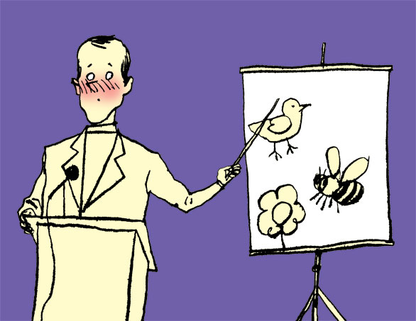

Slide 5
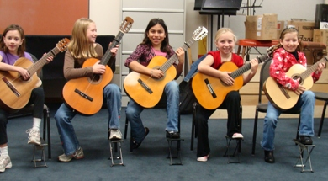

Slide 6


Slide 7
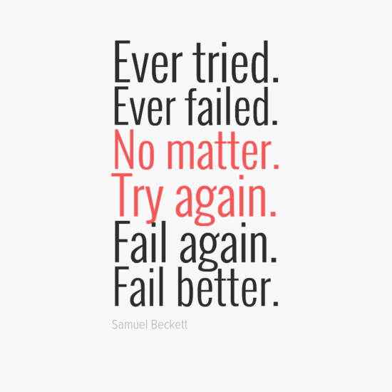

Slide 8

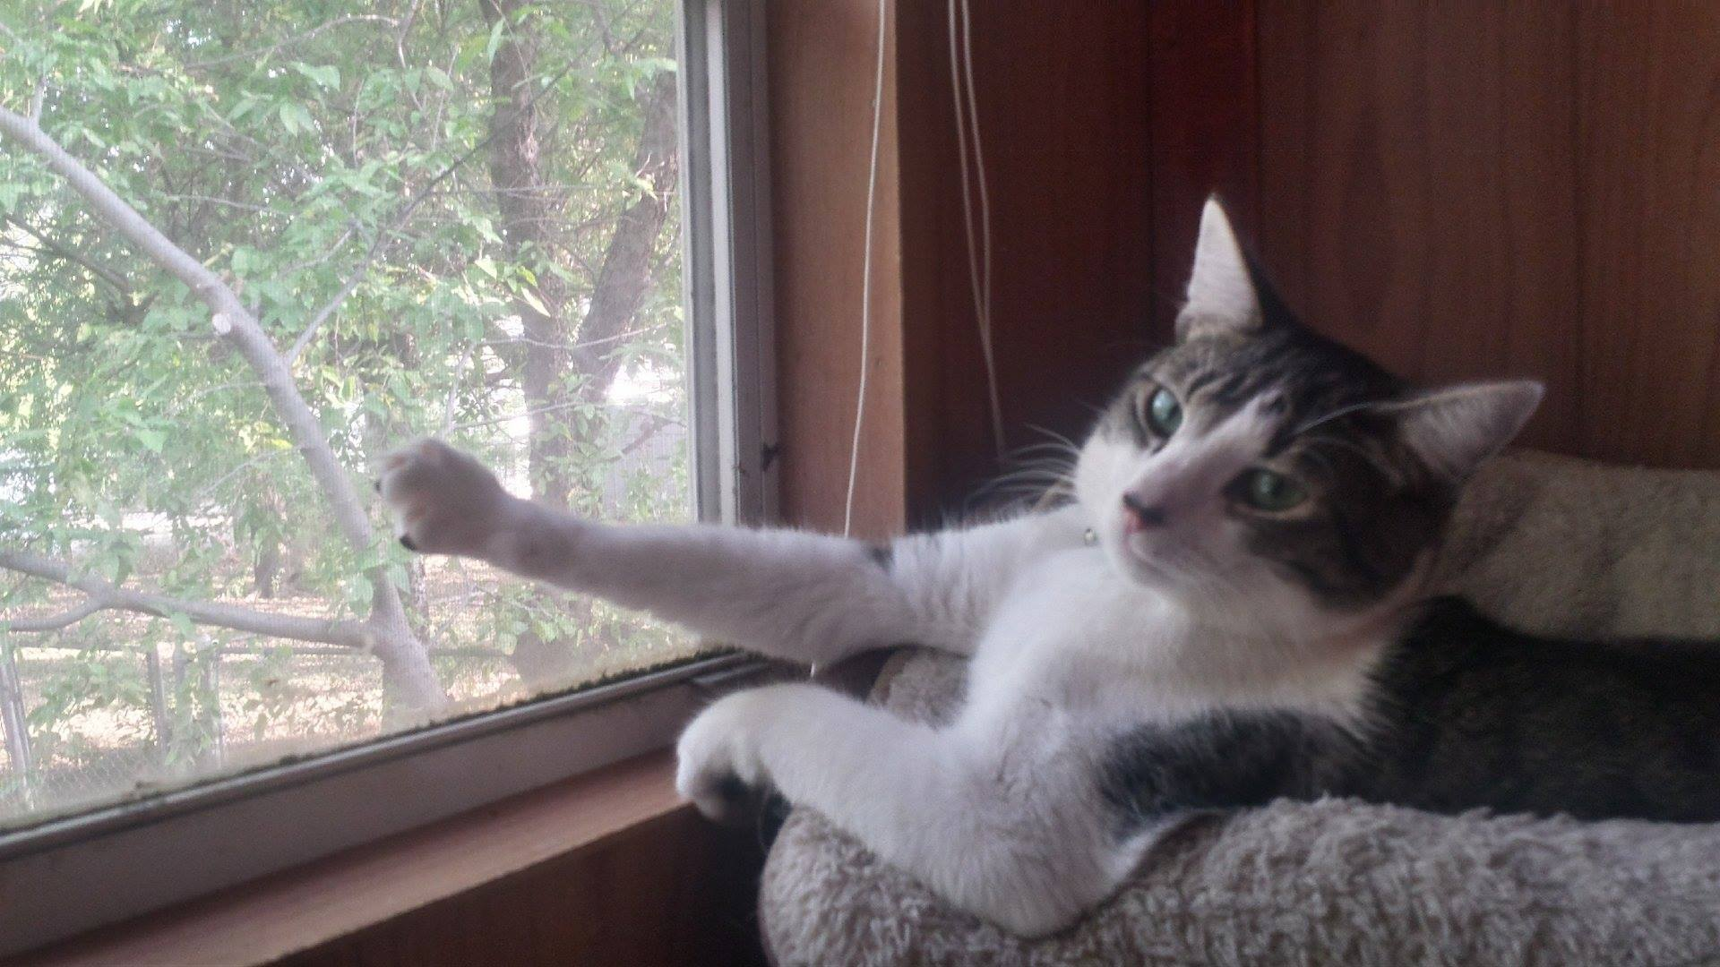
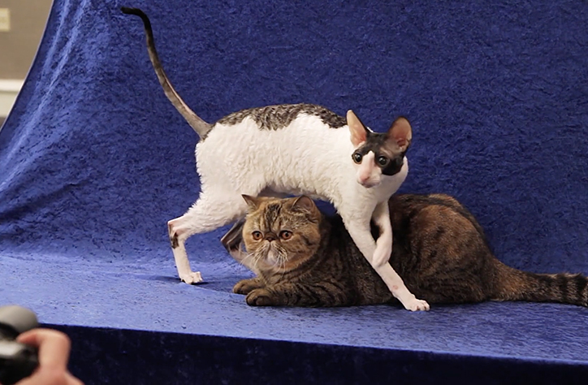
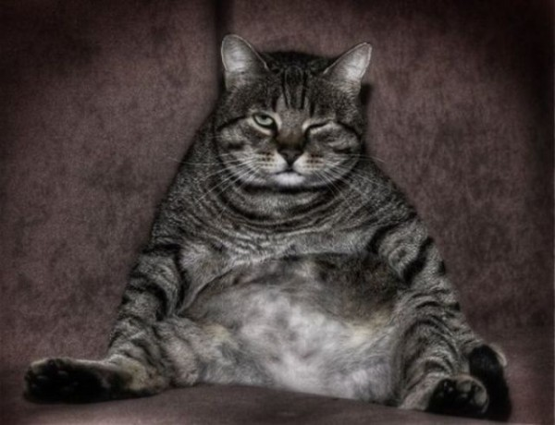

Slide 9


Slide 10


Slide 11


Slide 12
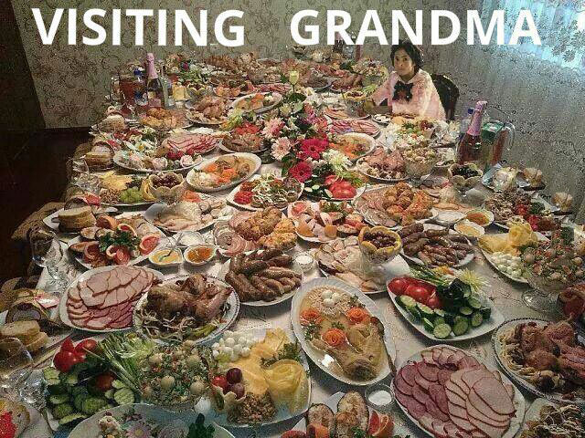
HONORS

Slide 13
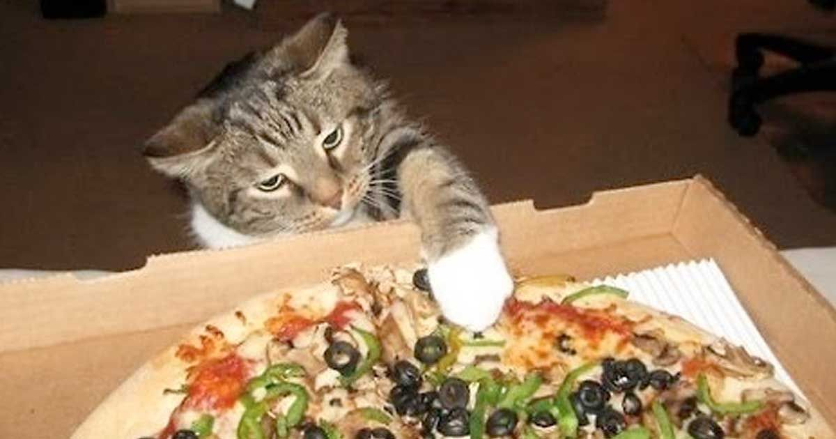
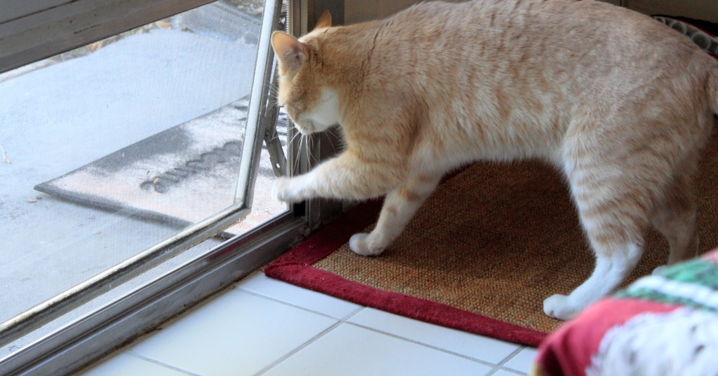
HONORS

Slide 14

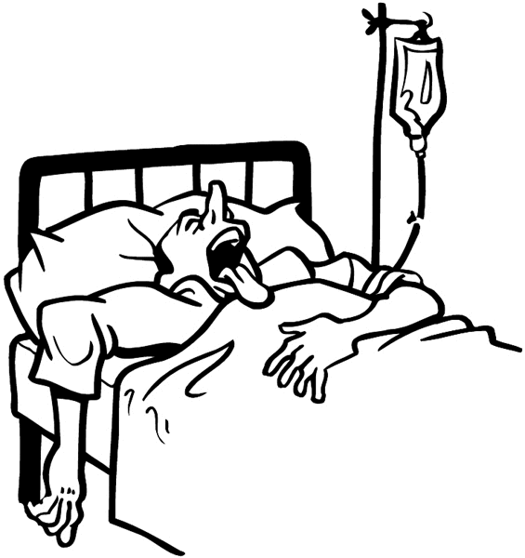



HONORS

Slide 15
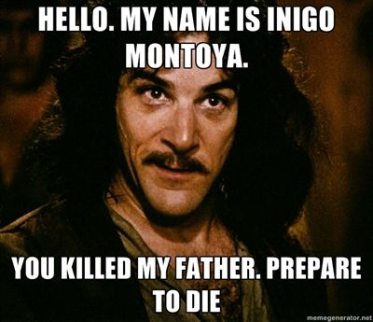

Slide 16



HONORS

Slide 17
Arrange your words in a spectrum from left to right, from negative to positive words.
BAD NEUTRAL GOOD
CONNOTATION CONNOTATION

Slide 18
Charades or Pictionary!
In your pod, put one person’s words face down on a desk.
Take turns selecting a word and then acting it out or drawing it out. Don’t use words!
The person who guesses the correct word must use it in a sentence and write it down.
Then, it is their turn to act or draw!
* You can’t just randomly say all the words!

Slide 19
On your half sheet of paper . . .
Select one of the words you find to be the most difficult.
Come up with a memory trick for the word that includes…
    A definition
    A picture
    A sound mnemonic
    Two sentences using the word in two different parts of speech (i.e. abduct AND abduction)

Slide 20
