Slide 1
Book Club Day!
1. Get into your clubs, and take out your books and role packets.
2. Double check to make sure your role sheet is done!
3. Write down HW: Finish 1 page of writing
4. Continue reading your book.

Slide 2
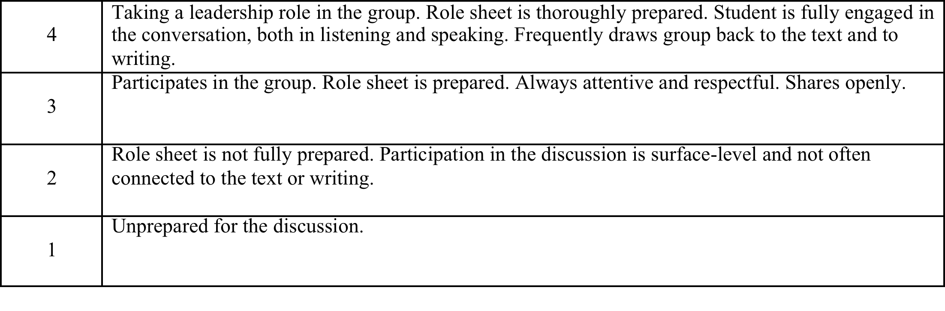
How Am I Graded?
4 = A / A+
3 = B / A
2 = C / B
1 = D / C
0 = 50

Slide 3
1. Summary
Summarizer share what he or she has prepared for the group.
Group members ask clarifying questions.
1-2 minutes

Slide 4
2. Opening Discussion
Discussion director has identified questions to lead group discussion. She or he leads conversation to include everyone. This discussion must be focused on the writing.
10-12 minutes

Slide 5
3. Literary Luminescense
Literary luminary leads the discussion . . .
Direct group members to the page your passage was on.
State why you chose the passage.
Read the passage aloud.
Lead a short discussion on that passage and its relation to the literary device. What else do other people like or notice about the passage?
3-4 minutes

Slide 6
4. Connections
Connector leads discussion . .
Share a part of the book
Share how it relates to your life
Tell a story from your life
Ask your question to the group.
Each member should participate but you will never be forced to share.

Slide 7
5. Wrap Up
Each member shares a writing lesson she or he has learned and would like to try in her or his memoir.

Slide 8
6. Writing Time
As a group, decide on a writing topic (most likely what the connector got you to talk about) and a technique to try based on your discussion today.
Write for 5-10 minutes on your own personal story.
Title your page w/today’s date and Book Club #2
One page minimum due tomorrow!

