Slide 1
Socratic Seminar Images
Bar at the Folies-Bergere
&
Picture for Women

Slide 2
Get out . . .
The Love Song of J Alfred Prufrock
The TPCASTT of the Love Song
Your art analysis packet from yesterday
Then you can start working on the sheet you picked up at the door.

Slide 3
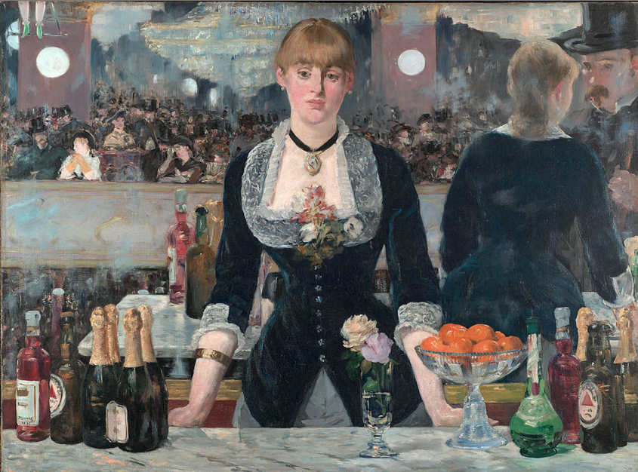
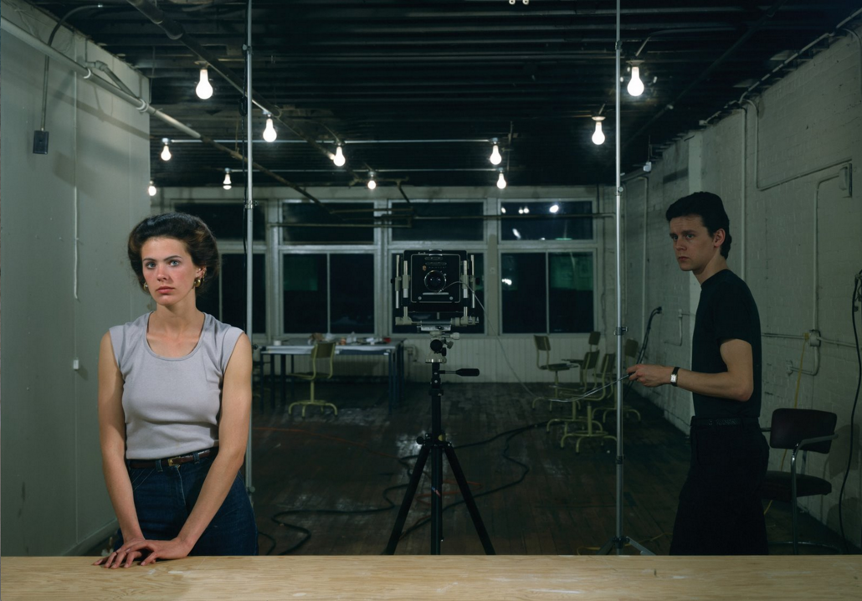
Bar at the Folies- Bergere
By Eduard Manet, 1882
Picture for Women
By Jeff Wall, 1979

Slide 4
Bar at the Folies- Bergere
By Eduard Manet, 1882
Q1: How can being around other people make you feel more alone?
What evidence is there that the central characters of our three texts feel more alone (or alienated) when around others?
Picture for Women
By Jeff Wall, 1979

Slide 5
Bar at the Folies- Bergere
By Eduard Manet, 1882
Q2: According to these pieces, how can you connect with others in a world where you feel alienated?
Picture for Women
By Jeff Wall, 1979

Slide 6
Bar at the Folies- Bergere
By Eduard Manet, 1882
Q3: What are the effects of self-consciousness on your sense of identity?
What is being expected of our three central characters?
What evidence do we have that they are being watched?
What stands in their way of acting like themselves?
Which of them is acting like themselves and which is listening to the expectations of society?
Picture for Women
By Jeff Wall, 1979

Slide 7
Bar at the Folies- Bergere
By Eduard Manet, 1882
Q4: In what ways do others’ expectations of you influence your own sense of self, either positively or negatively?
What evidence is there that the thoughts of society have shifted the characters’ mindsets or changed their actions?
Picture for Women
By Jeff Wall, 1979

