Slide 1
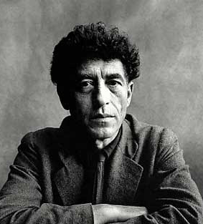
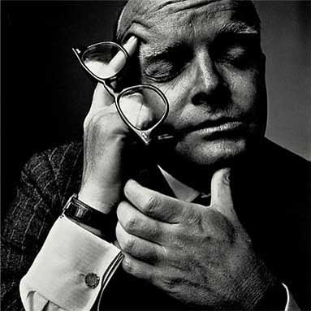

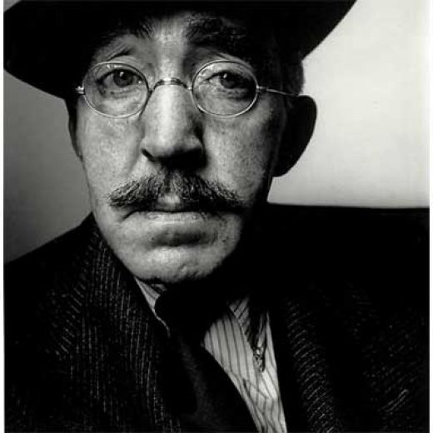

Slide 2
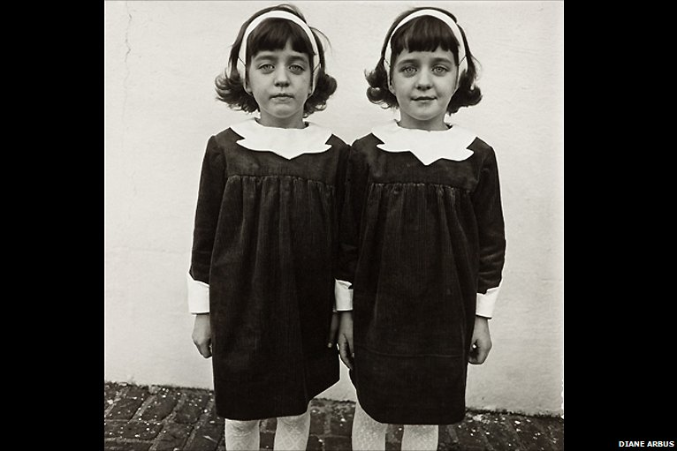

Slide 3
Do now
Begin reading “The Power of Detail.”
When done, write down in your WRITER’S NOTEBOOK the line that stood out most to you.
Explain why you chose that line.

Slide 4
Do now: Get out characterization HW.
Write down HW: write 1 scene from your memoir using the techniques we learned this week. (1 page minimum)
In your notebook, write the heading
9/4 Show, Not Tell
then answer the following questions:
What is the saddest make and model of a car? (include more description if you like)
What is the most depressing flower name?
What is the happiest tree species?
What is the most adventurous writing utensil? (be very, very specific)
What is the most romantic cereal?

Slide 5
Show, Not Tell
Practice

Slide 6
He was mad.

Slide 7
His fists slammed onto the desk and his
nostrils flared.

Slide 8
She looked at me, tilting her head slightly, as a smile crept over the corners of her dimpled lips.

Slide 9
She was flirting with me.

Slide 10
He was in a bad mood.

Slide 11
The landscape was beautiful.

Slide 12
I was nervous.

Slide 13
She was wearing too much make-up.

Slide 14
He looked at me condescendingly.

