Slide 1
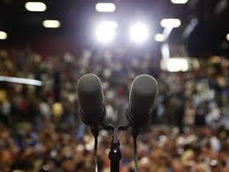


The Makings of a Good Speech
Mr. Michel
English I
2/6/2015

Slide 2
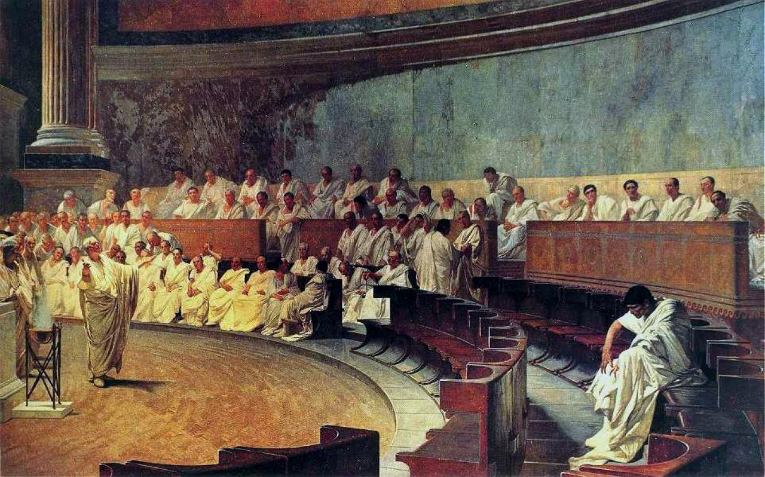
So, where did it all begin?
Public speaking (sometimes termed Oratory) is the process and act of speaking or giving a lecture to a group of people in a structured, deliberate manner intended to inform, influence, or entertain a listening audience.
Some of the earliest forms of Oratory took place in Ancient Egypt and Greece.

Slide 3

Effective Speechwriting
Public speaking in the 21st century may still share similarities with traditional practices, but much more has been discovered in writing an effective speech.
To help us understand this, we’ll look at a neat set of practices to promote the creation of an effective speech:

Slide 4

Hold onto that K.O.R.D.!
Know the subject you want to examine in your speech by researching background information.
Organize your thoughts by planning or making a list of important points.
Revise your plans and work them into a brief paragraph that can be spoken publicly.
Deliver your speech with confidence in your work, and believe in the message you are attempting to share.

Slide 5

Know the subject you want to examine:
Be able to answer the questions:
What do the members of the audience have in common?
Do they expect discussion about a specific subject and, if so, what?
Why are they interested in your topic?
What do they know, and what do they need to know?

Slide 6

Organize your thoughts by planning:
This is where you pick up the information, connect the ideas and arrive at the insights that make your talk fresh.
Gather far more information than you need.
Arrange your research and notes into general categories and leave space between them.
Go back and rearrange.
Fit related pieces together like a puzzle.

Slide 7
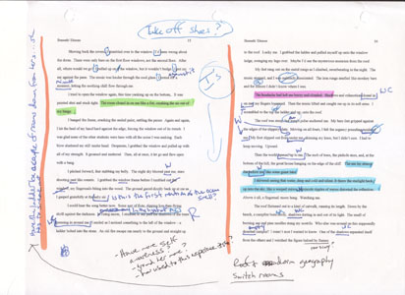
Revise your plans and work them into a brief paragraph that can be spoken publicly.
To better help you revise your speech, consider practicing the following:
Double check your understanding of your topic.
Make links between different topics to see how the whole subject fits together.
Remind yourself of material you may have forgotten.

Slide 8

Deliver your speech with confidence in your work, and believe in the message you are attempting to share.
Don’t ever forget the impact words can have on people. Make use of the platform you’ve been given and speak wholeheartedly. Above all…BELIEVE IN YOURSELF!

