Slide 1
The Civil Rights
Era in Images
Mr. Michel
English I

Slide 2
"As a doctor, I am qualified to tell you that this course of treatment will likely generate the best results.”

Slide 3
"As a doctor, I am qualified to tell you that this course of treatment will likely generate the best results.”
Ethos

Slide 4
"If we don’t move soon, we’re all going to die! Can’t you see how dangerous it would be to stay?”

Slide 5
"If we don’t move soon, we’re all going to die! Can’t you see how dangerous it would be to stay?”
Pathos

Slide 6
"The data is perfectly clear: this investment has consistently turned a profit year-over-year, even in spite of market declines in other areas.”

Slide 7
"The data is perfectly clear: this investment has consistently turned a profit year-over-year, even in spite of market declines in other areas.”
Logos

Slide 8
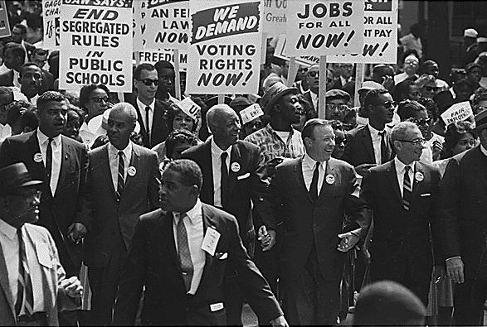
Image 1

Slide 9
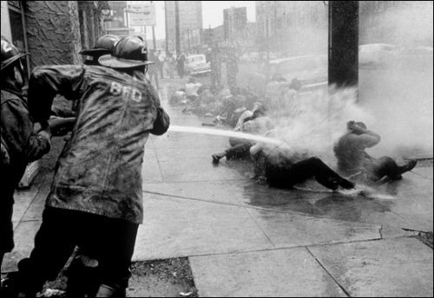
Image 2

Slide 10
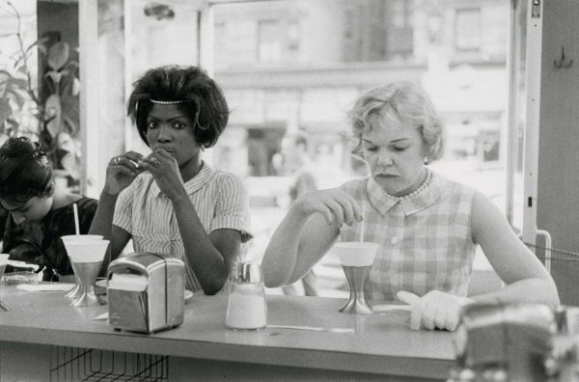
Image 3

Slide 11
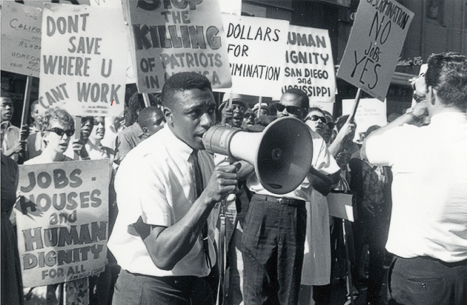
Image 4

Slide 12
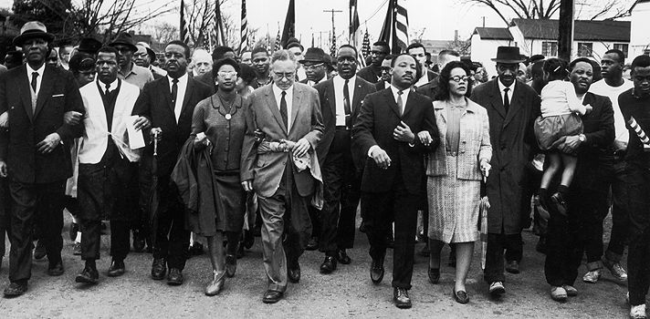
Image 5

Slide 13
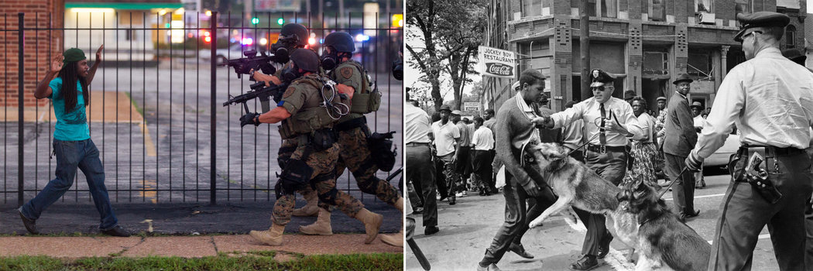
Image 6

Slide 14

Image 7

Slide 15
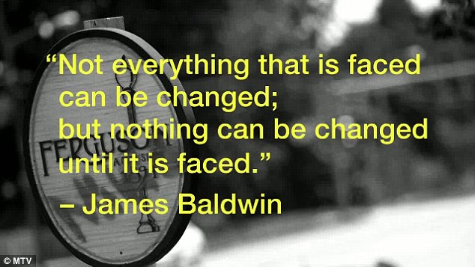
Image 8

Slide 16
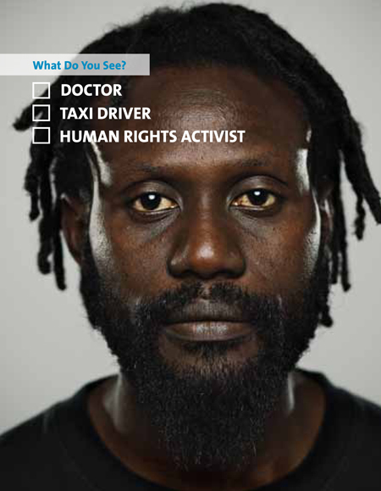
Image 9

Slide 17
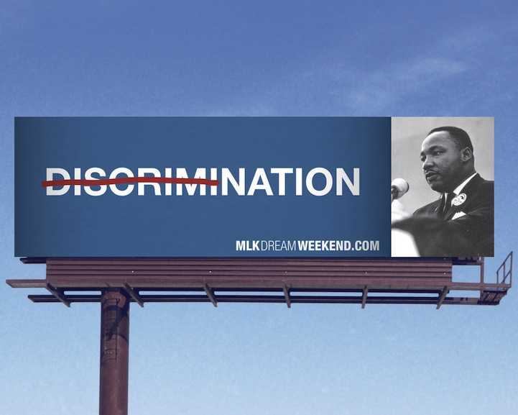
Image 10

Slide 18

Image 11

Slide 19
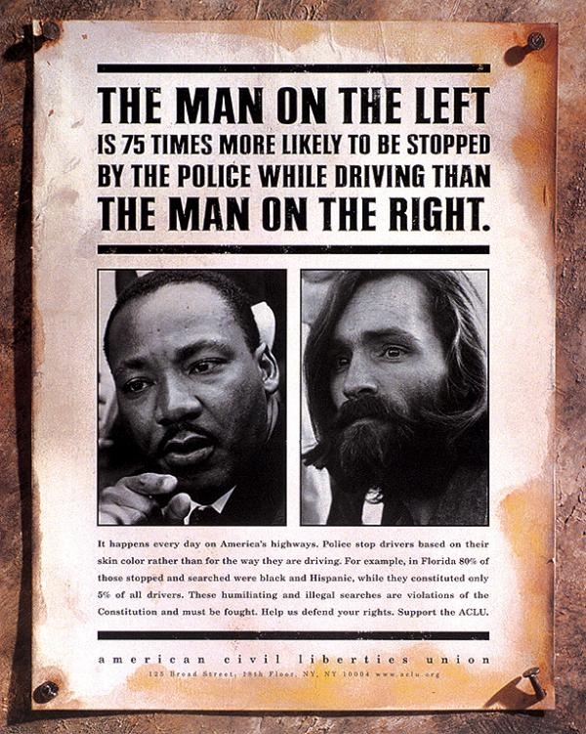
Image 12

